Slide 1
Tower Dryer
Present by: Khai Akshat

Slide 2
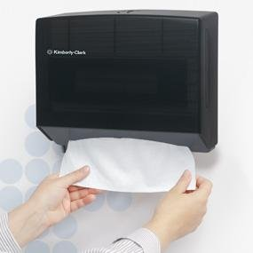
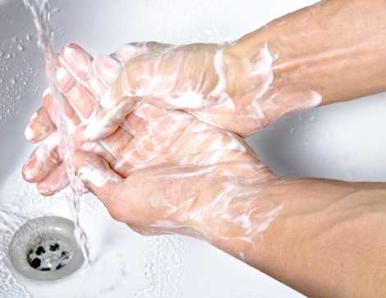
Disable the second image until I talk about dry hands
Notes:
Disable the second image until I talk about dry hands

Slide 3
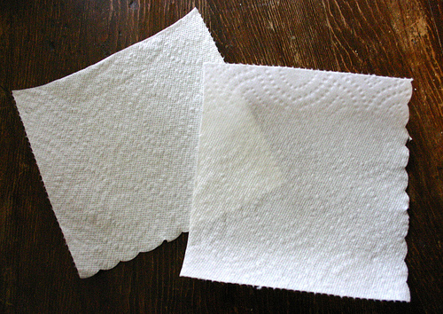
Slide when you referred about 80B
= 80.000.000.000 (80 BILLIONS !!!)

Slide 4
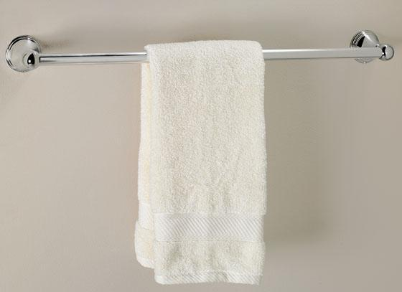
Slides when we talk about damp towel

Slide 5

Slide where you introduce the Tower Dryer

Slide 6


Slide when you talk about your sister

Slide 7
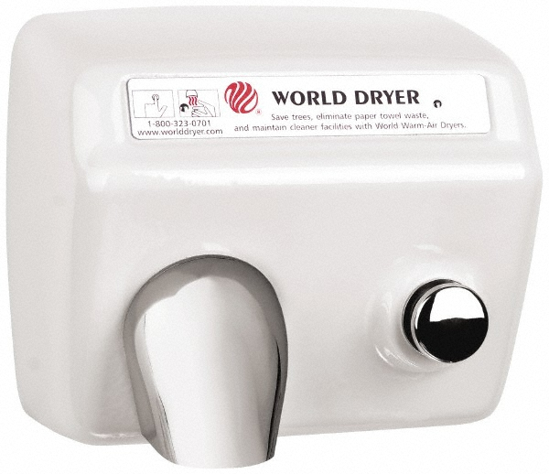
Sent you the audio, or youtube your choice, next to the dryer

